Slide 1
VPLP School-Like Management System
Student VPLP Attendance – Mamapapa Apps
Centre Event Push Notification – Mamapapa Apps
How to use mobile device to conduct VPLP?

Slide 2
VPLP Student Attendance Feature

Slide 3
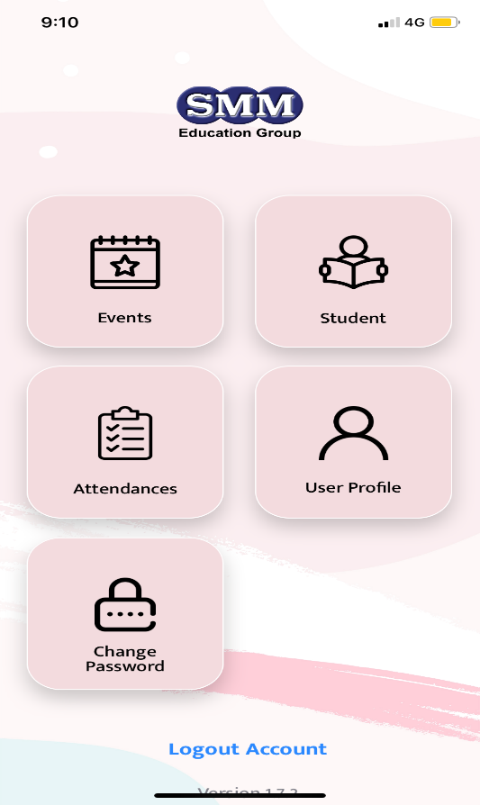
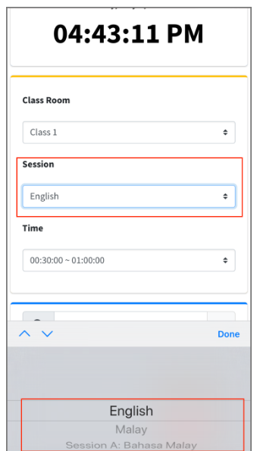
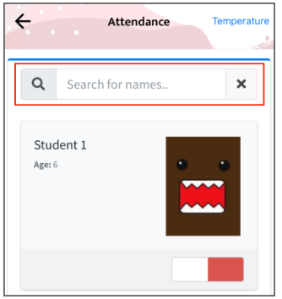
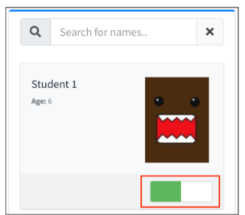
1.1) Support VPLP Attendance Taking
Step 1 Screen 1: Go to Dashboard.
Step 2 Screen 2: Pick Classroom & Session.
Step 3 Screen 3: Search for student name.
Step 4 Screen 4: Slide to clock in.
1
2
3
4

Slide 4
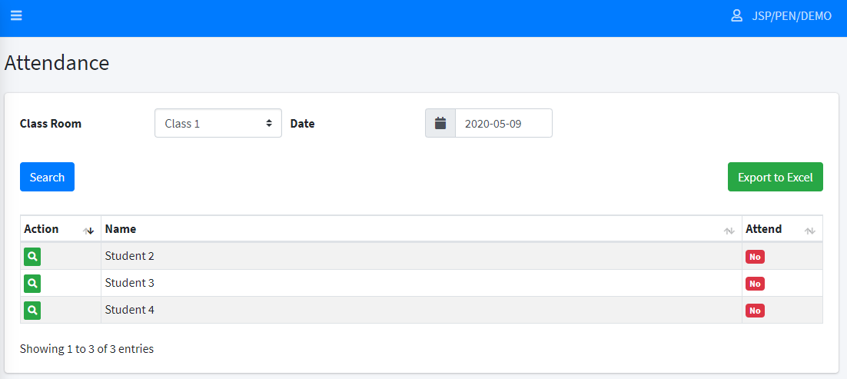
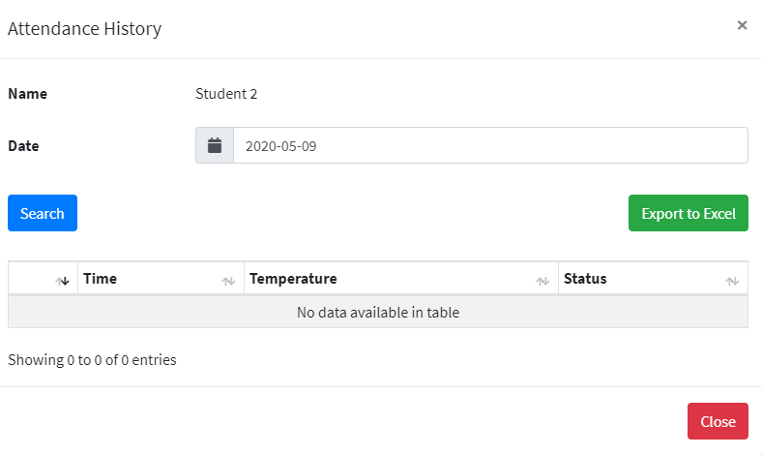
1.2) Attendance Reporting
Report 1: Breakdown the VPLP Attendance Classes.
Report 2: Student individual attendance report.
Above reports are able to extract as excel from Center Management (CM) Portal.

Slide 5
1.3) Tutorials
How to manage VPLP session in CM Portal
https://support.smmcloud.asia/kb/faq.php?id=68
(CI App) Manage student VPLP attendance
https://support.smmcloud.asia/kb/faq.php?id=66
How to manage attendance report in CM Portal
https://support.smmcloud.asia/kb/faq.php?id=67
1.4) Zoom Virtual Background
Prerequisites https://support.zoom.us/hc/en-us/articles/210707503-Virtual-Background

Slide 6
Centre Event Push Notification Tutorial

Slide 7
Tutorial on how to set & notify your centre event? https://support.smmcloud.asia/kb/faq.php?id=35

Slide 8
How to use mobile device conduct VPLP?
1
Download our Virtual School Like Environment Slide from
https://support.smmcloud.asia/
2
Download Power Point App in
Google Play or Apps Store
3
Open ZOOM Meeting App,
Go to Setting & Enable Original Sound
6
Go to the folder you store your Virtual School Like Slides/ Usually they auto kept in your Download Folder
5
Share Screen
with you mobile phone
4
Join In Meeting &
Enable Original Sound
7
Open Virtual School Like Slides
with Power Point app installed earlier
8
In your Power Point, to start your slide by pressing at the top right corner
9
Done.

Slide 9
How to enable music/sound when share screen using mobile devices using ZOOM?

Slide 10
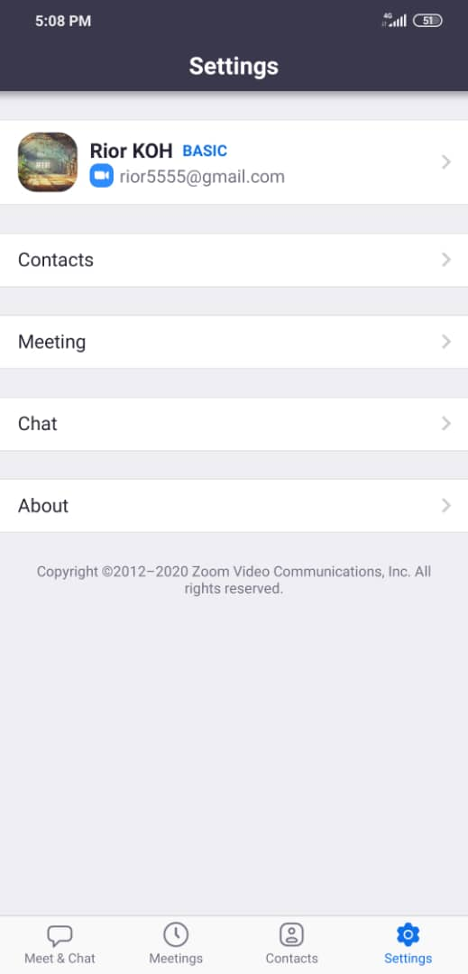
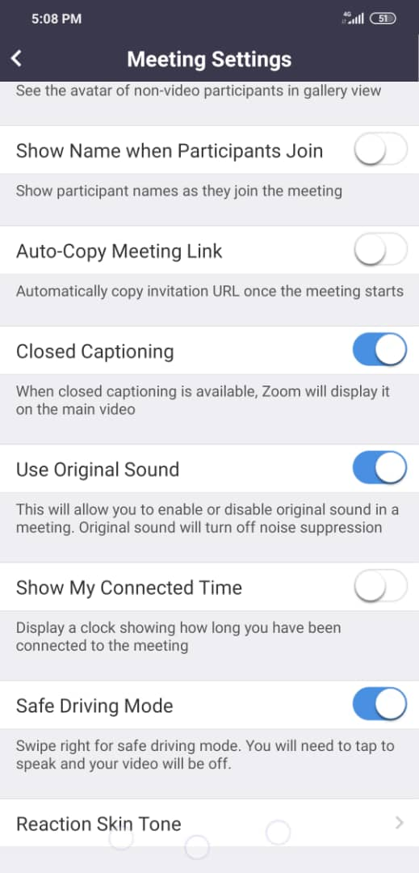
Share Audio/Music using phone
2
3
4
Join in / Host a Meeting
7
1
6
5
Must Join in Audio & Unmute

